Slide 1
Technology & Social Media Weapons in Family Law
Rebecca Hall Coleman
Bill Hall & Associates
2101 Clinton Avenue West, Suite 502
Huntsville, Alabama 35801
(256) 319-0590
Rcoleman@HallLawPractice.Com

Slide 3
Social Media in Family Law
Can I get it?
If yes, then how?
ETHICAL CONSIDERATIONS

Slide 4
Discovery Considerations
Is it material and relevant?
Is the requested content at issue?
Is the request overly-broad in time or in scope?
Is there an expectation of privacy?
Will the requested documentation aid in impeachment of a witness or opposing party?

Slide 5
How can I get what I want?
Subpoena to Social Media company
Most social media sites state that they will only disclose records in accordance with (1) their terms of service and (2) applicable law, including the federal Stored Communications Act (“SCA”, 18 U.S.C 2701-2712. Stated plainly, records will not be provided unless the subpoena is issued:
1. pursuant to a valid subpoena in connection with a criminal investigation;
2. there is a court order issued under 18 U.S.C. Section 2703(d) (even then you can’t get the content of certain communications); or
3. Pursuant to a search warrant
Request for Production
Some courts hold that social media is discoverable and due to be provided, so long as the request is reasonably calculated to lead to the discovery of admissible evidence – such as hidden assets or information relevant to custody or fault.
Furthermore, in NY, in Forman v. Henkin, records from Facebook were Ordered to be turned over even after the account was disabled. (New York Courts Rule On Private Facebook Accounts In Discovery (romanolaw.com)

Slide 6
Words Matter Mailholt v. Home Depot No. CV 11-03892 (C.D. CA)
What did NOT work…
“Any profiles, postings or messages (including status updates, wall comments, causes joined, groups joined, activity streams, blog entries) from social networking sites from October 2005 (the approximate date Plaintiff claims she first was discriminated against by Home Depot…”
This request was found to be overly-broad and could easily implicate a plethora of irrelevant messages
What worked…
“All social networking communications between Plaintiff and any current or former Home Depot employees, or which in any way refer [or] pertain to her employment at Home Depot or this lawsuit.”

Slide 7
Data Never Sleeps Source: Data Never Sleeps 8.0 ( https://www.domo.com/learn/data-never-sleeps-8)
Facebook
Instagram
Twitter
TikTok
SnapChat
GroupMe (cannot download the data)
WhatsApp
Venmo
CashApp (can get actual monthly statements)
PayPal (can get actual monthly statements)
Amazon
Uber

Slide 8
1. Select “Menu” - On the bottom right of the mobile screen 2. Select “Settings & Privacy” 3. Scroll down to “Download your Information” 4.Re-enter user id and password 5. Select “Request a Copy” - The user can limit the data provided - The user can limit the time period for which they provide information Note: You can select “Access your Information” (instead of “Request a Copy”) - This shows everything and everyone searched for, comments, likes, and posts.

Slide 9
What about “Secret Conversations” on Facebook Messenger?
- Facebook Messenger allows for “secret conversations” to occur by employing end-to end encryption.
- Thus, when this feature is used, messages can only be read on the specific devices that the sender and the receiver used for the conversation.
- It is unclear if these messages will show up in a data download.

Slide 10
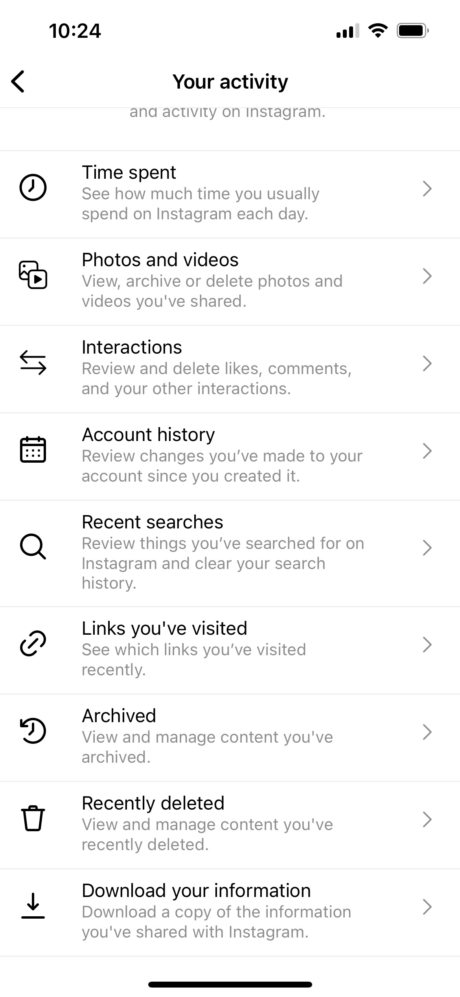
On a mobile device, select the image on the bottom right that looks like the outline of a person
Select the three horizontal bars on the top right of the screen
Select “Your Activity”
Select “Download Your Information”
NOTE: If you have the device in hand, there are several things that can be viewed immediately.

Slide 11
1. Select the profile picture in the upper lefthand portion of the screen 2. Select “Settings and Privacy” 3. Select “Download an Archive of your Data” 4. The individual will have to re-enter their username and password AND a security code will be sent to their phone 5. Select “Request Archive” Note: The individual will not be able to limit what is given or the time period. Also, twitter does not allow for a “sneak peek” like Facebook and Instagram

Slide 12
Select the “person” on the bottom righthand side of the screen
Select the three horizontal bars on the top righthand side of the screen
Select “Settings and Privacy”
Select “Privacy”
Select “Download your Data”
NOTE: Make sure the individual requests the “TXT” file format NOT the “JSON” format

Slide 13
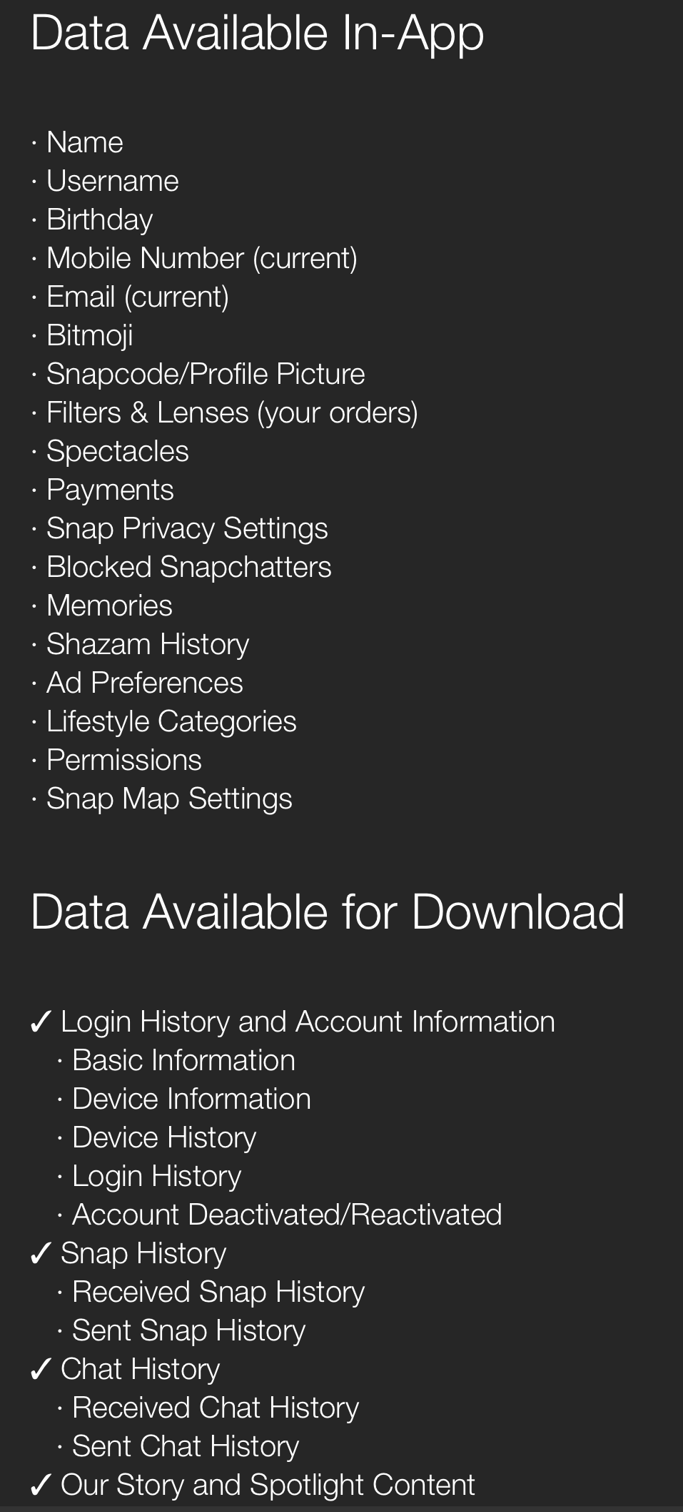
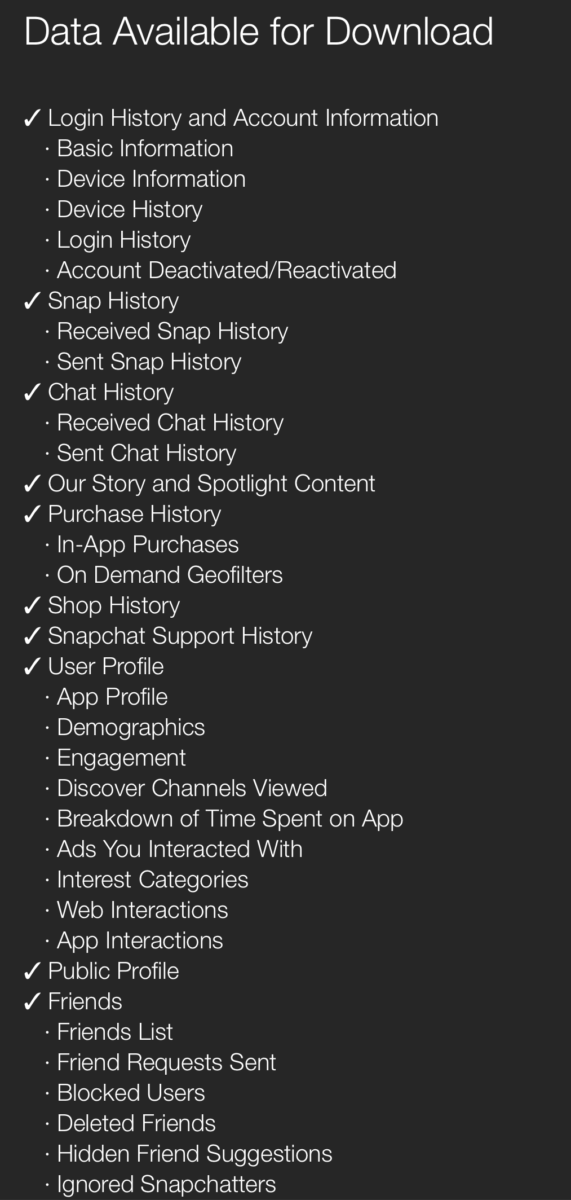
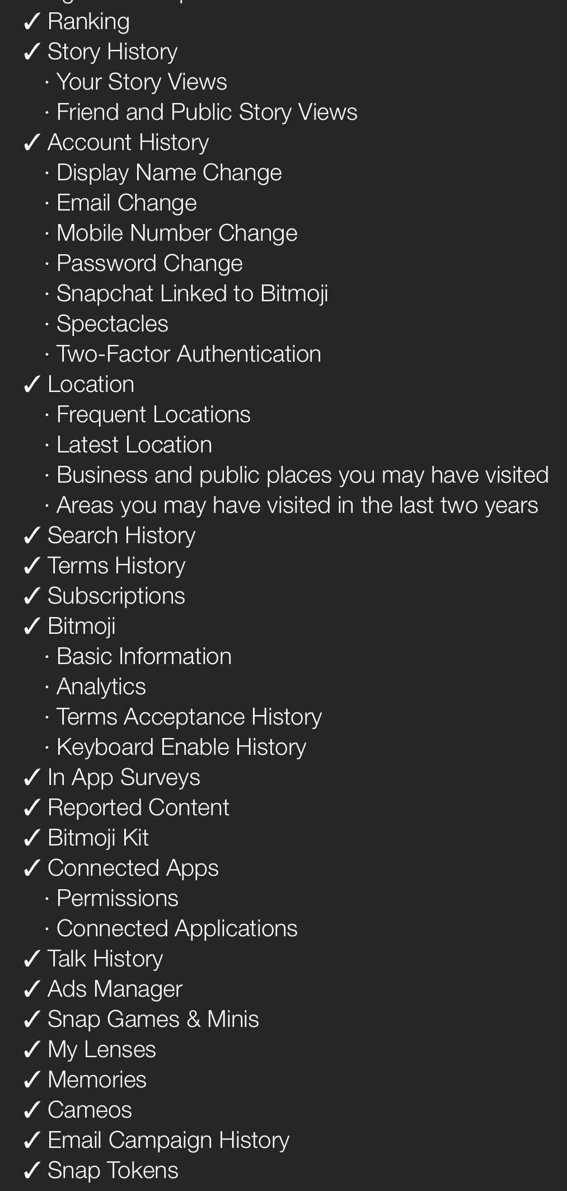
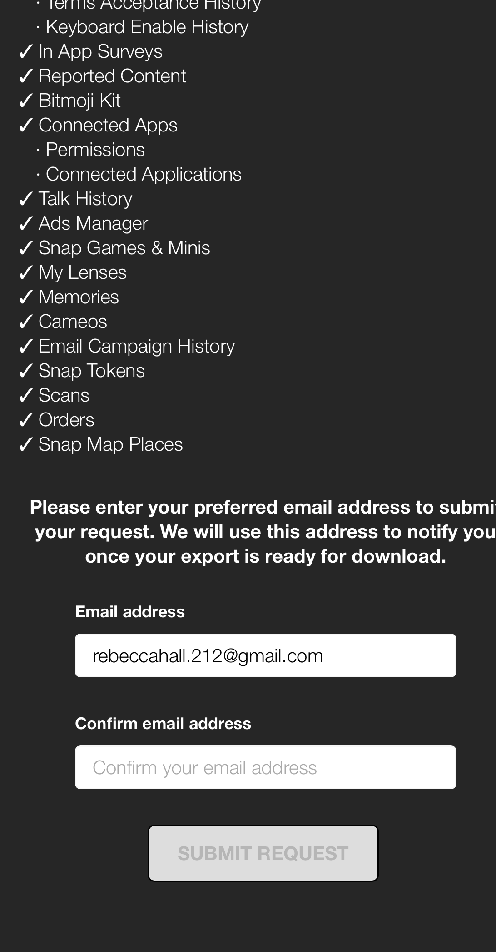

Slide 14
Click the “Bitmoji” Person or “Profile Picture” on the top lefthand side of the screen;
Select the “Tool” image on the top righthand side of the screen
Select “My Data”
- Make sure they give you the entire ZIP drive as individual files within the ZIP can be deleted
NOTE: The “Snap History” and the “Chat History” will not show the content – just that snaps and chats were exchanged.

Slide 15
Click “Settings”
Go to Your Account
Select “Request Account Information”
Select “Request Report” for immediate viewing OR Select “Download Report.” If downloaded, it will come as a ZIP file. This normally takes 3 days.
NOTE: In some cases, it is possible to “restore” chats that have been deleted – For Example:
On an iPhone:
Verify that an iCloud backup exists by logging in to the Cloud and going to WhatsApp -Settings – Chats – Chat Backup
If you can see when the last backup was performed, delete and reinstall WhatsApp
After verifying your phone number, follow the prompts to restore the chat history

Slide 16
*Cannot download data via the app”
1. Log in to your account using a web browser;
2. Select “Statement”
3. To download, select “Download CSV”
By default, this will only provide data for the last 90 days
However, you can view any time period from the beginning of the account, provided that it can only be viewed and downloaded one month at a time.

Slide 17
1. Go to Amazon.com and log in to your account. (Could not make it work on the App)
2. Tap “Account & Lists” on the top right.
3. Choose “Download Order Reports” under the “Ordering and shopping preferences” section.
4. Select a report type: “Items” is default and shows all shipments, but use the drop-down to switch to “refunds” or “returns.”
5. Select a start and end date.
6. Select “Request report.”

Slide 18
*You can view “trip history” on the App, but to download a report, you must use a Web browser*
Once logged in to Uber, download the “RideShare Trip Stats” extension
Select the “Extension” icon (next to the address bar )and click “OK” to the prompt
Finally you will be on the “Trips” page (which is almost identical to the one on the app);
Click the extension icon again and it will start processing and downloading all data to create the report
NOTE: When requesting data, you can get a detailed report with individual trip data, but the individual must select this option.

Slide 20
Your iPhone will tell on you…

Slide 21
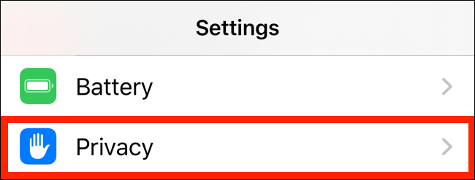
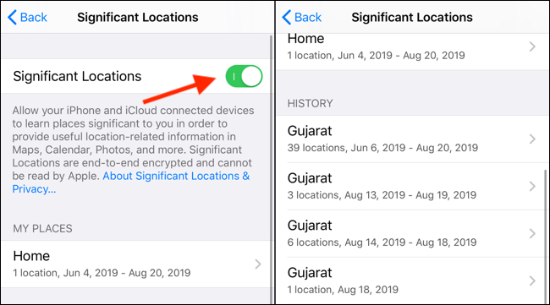
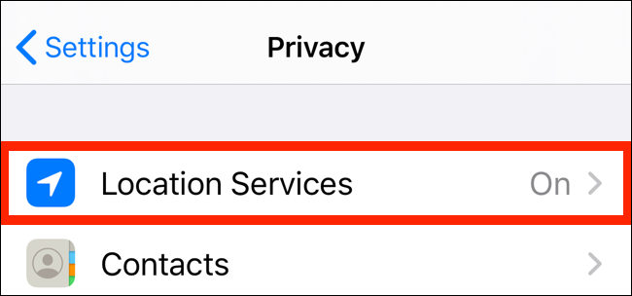
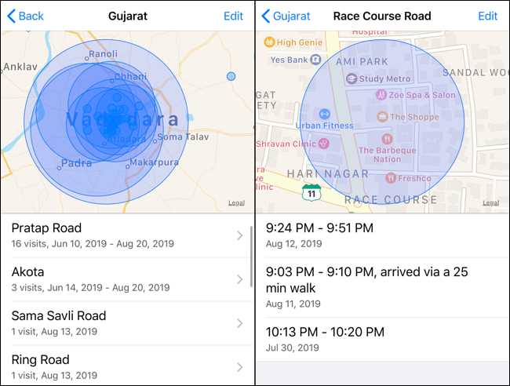
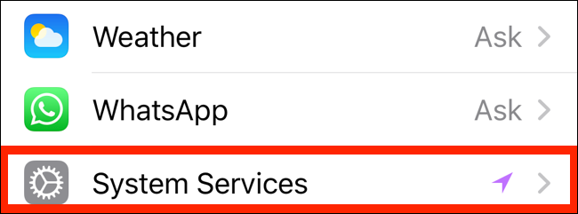
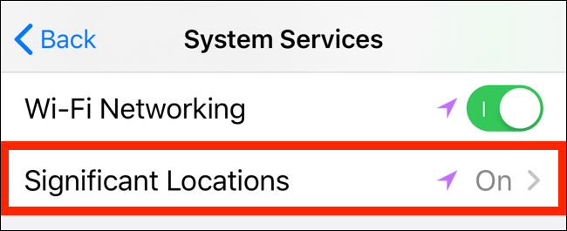
When you tap on a location collection, it will show a visual breakdown on the next screen of dates and times said location was visited.

Slide 22
Beware of Secret Applications
Applications to store secret photos and videos:
Secret Calculator, Vault, Picture Safe, The Screen Vault, etc.
Applications that Allow for texting, calling and/or file sharing:
CoverMe, Viber, Signal Private Messenger, Threema, Telegram, Wire, Wickr Me, Line, etc.

Slide 24
Ethical Considerations 12 Rules for Ethically Dealing With Social Media (americanbar.org)
Attorneys may NOT contact a represented person through social networking sites.
Attorneys may NOT contact a party or a witness by pretext.
Attorneys may contact unrepresented persons through social networking websites but may NOT use a pretextual basis for viewing otherwise private information on those websites.
Attorneys may advise clients to change the privacy settings on their social media page. In fact, lawyers should discuss the various privacy levels of social networking with clients, especially given the implications of failing to change these settings.
Attorneys may instruct clients to make information on social media websites “private” but may NOT instruct or permit them to delete or destroy relevant photos, links, texts, or other content, so that it no longer exists. (NOTE: If a client deactivates twitter, it will delete after 30 days.)

Slide 25
Ethical Considerations Continued 12 Rules for Ethically Dealing With Social Media (americanbar.org)
Attorneys must obtain a copy of a photograph, link, or other content posted by clients on their social media pages to comply with requests for production of other discovery requests.
Attorneys must make reasonable efforts to obtain photographs, links, or other content about which they are aware if they know or reasonably believe it has not been produced by their clients.
Attorneys should advise clients about the content of their social networking websites, including their obligation to preserve information, and the limitations on removing information.
Attorneys may use information on social networking websites in a dispute or lawsuit.
Attorneys may connect with judges on social networking websites provided the purpose is not to influence judges in carrying out their official duties.

Slide 27
Online Tools
True People Search (www.truepeoplesearch.com)
- Searches billions of public records – gives address history, phone numbers, relatives, email addresses and more.
- FREE!
Reverse Phone Lookup (www.freephonetracer.com)
- See an odd number in cell phone records? Use this site to search for the owner of said number.
Wayback Machine (www.archive.org) and PageVault (www.page-vault.com)
- Allows a user to capture a web page as it appears now for use as a trusted citation in the future.
- Doesn’t work for all sites.
NetLingo (www.netlingo.com)
- An Internet dictionary that defines digital communications – include texting jargon and online acronyms
Emoji (www.emojipedia.org)
- Provides an actual definition for each emoji

