Slide 1
Why & how Lawyers should embrace social media
MORRIS LILIENTHAL – HUSBAND | DAD | PERSONAL INJURY LAWYER

Slide 2
FROM COUCH TO 5K!
Problem: You want to engage on digital and social media, but…
You don’t know how OR you’re overwhelmed by the platforms and technology
Solution: Follow along and you’ll get some ideas and philosophies that you can take away and implement, now.

Slide 3
We’ve got trust issues
Consumers typically don’t trust advertising OR companies
We have 2 strikes against us:
Lawyers
Company

Slide 4
So what do consumers trust?
They trust people.
Your biggest asset as a lawyer is your reputation!
Use digital and social media to grow your reputation and referrals!

Slide 5
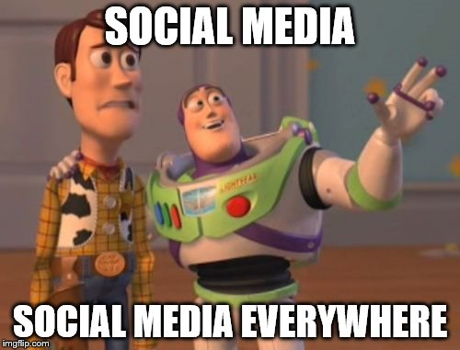

Slide 6
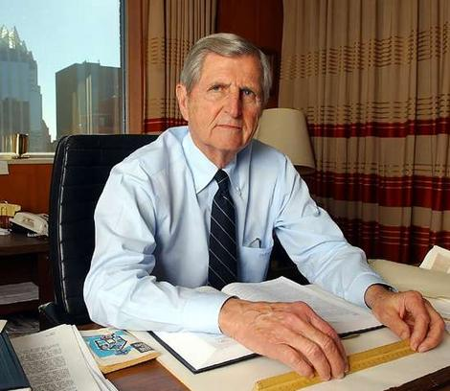
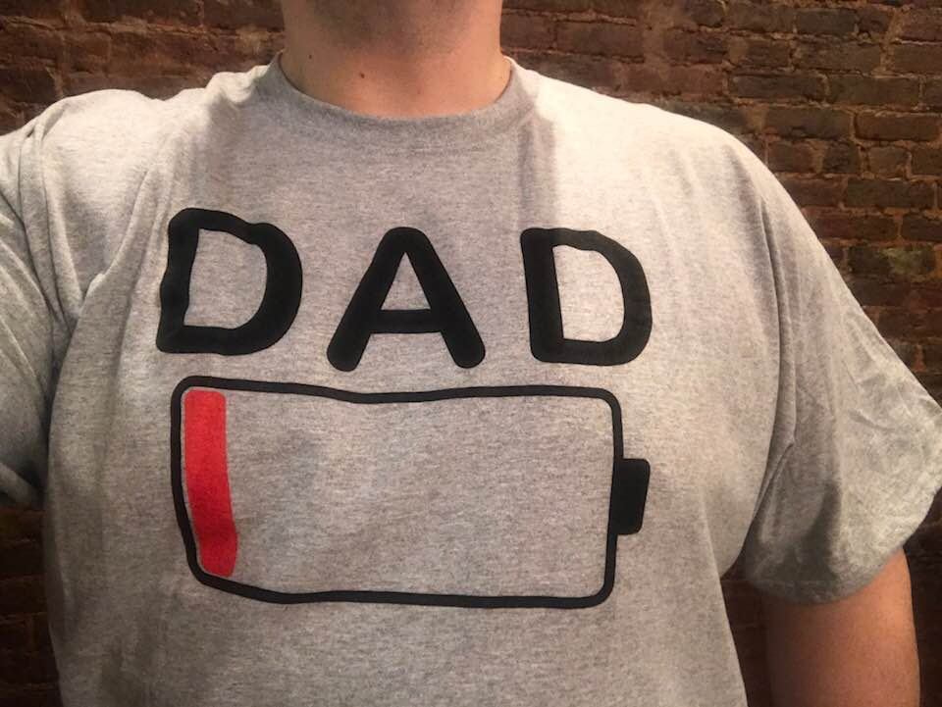
How do you build trust on social media?
Humanize Yourself
VS.
People trust (and hire) people, not companies.

Slide 7
What is your why?
Tell YOUR personal story, the story of your firm.
What are you passionate about? Share it with your audience!

Slide 8
This is my why

Slide 9
This is my why
This video has thousands of views and tons of shares/comments

Slide 10
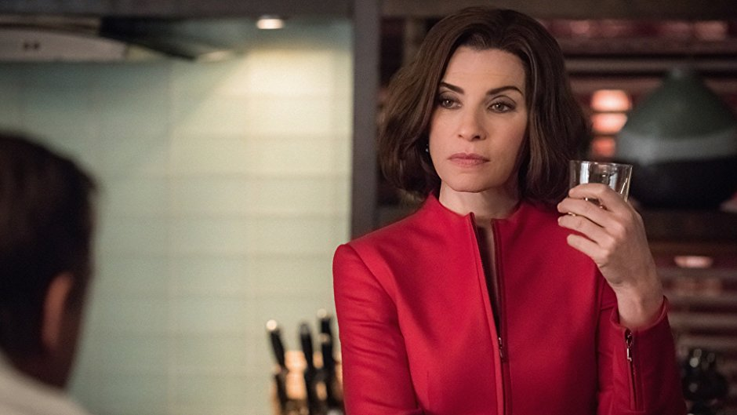
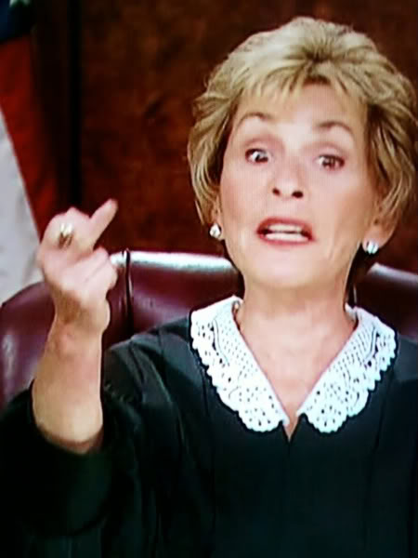
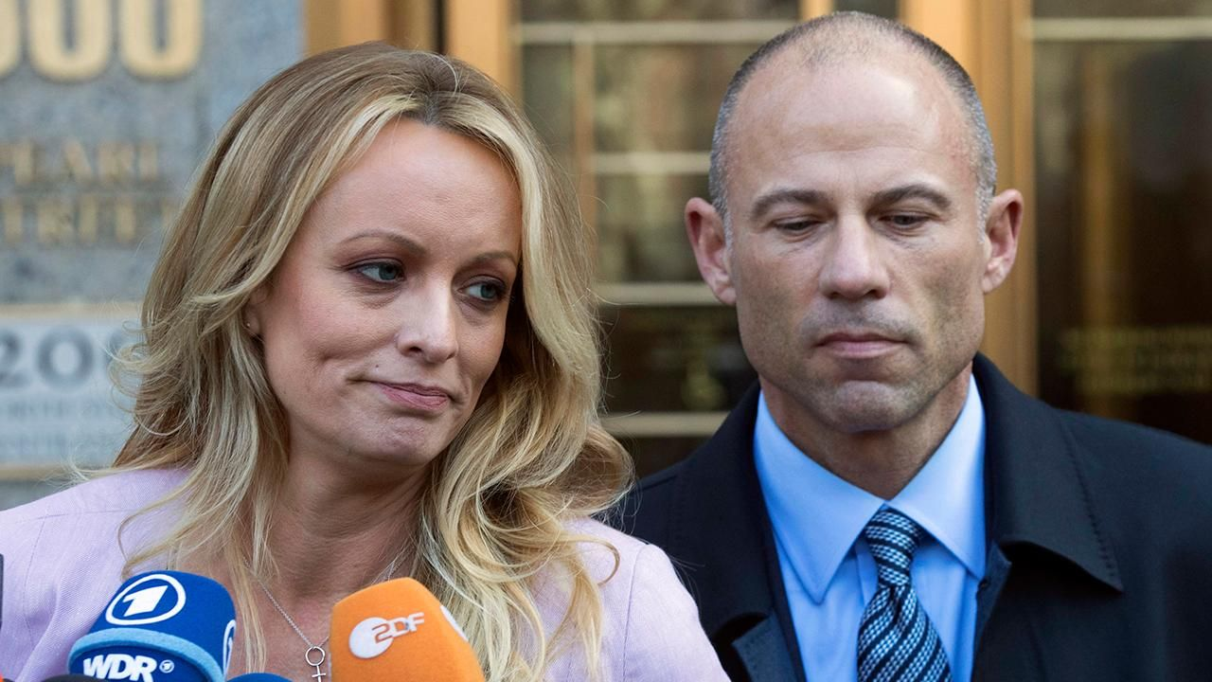
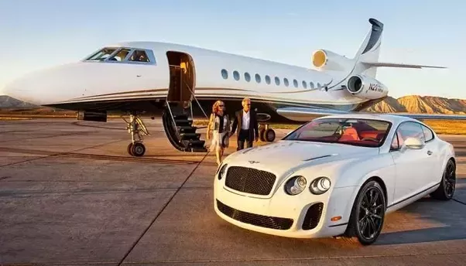
Why do I share this?
Connecting with people.
We are real people with families, interests, hobbies, and problems

Slide 11
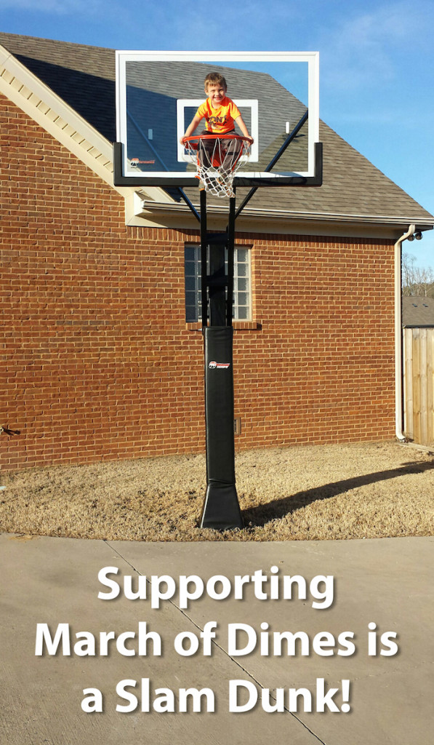
Team will
We use various ways to raise awareness:
Team Will website (TeamWill.net)
Facebook Page
Engaging graphics and videos

Slide 12
Shows originality
Shared across the country
Local TV interview
Shared by national
March of Dimes page

Slide 13
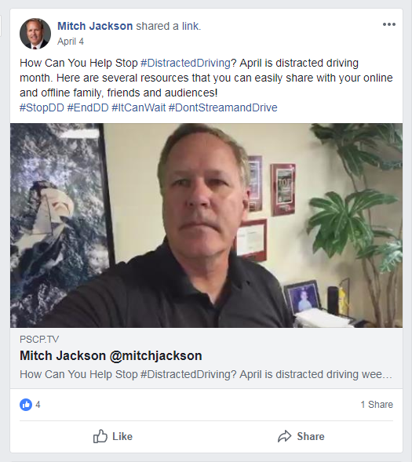
Other examples
Bernard Nomberg
Mitch Jackson

Slide 14
It’s not you, it’s me…
Embrace your “why” and your passions on social media.
Connect with people that share your passions.
These people will connect with you AND your law firm.
Know > Like > Trust = You taking care of all of their legal needs

Slide 15
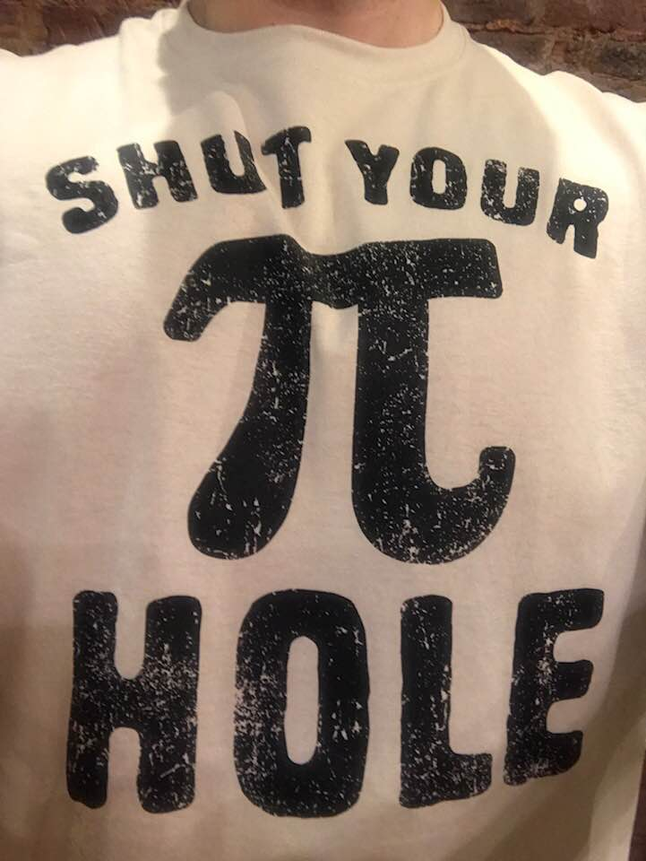
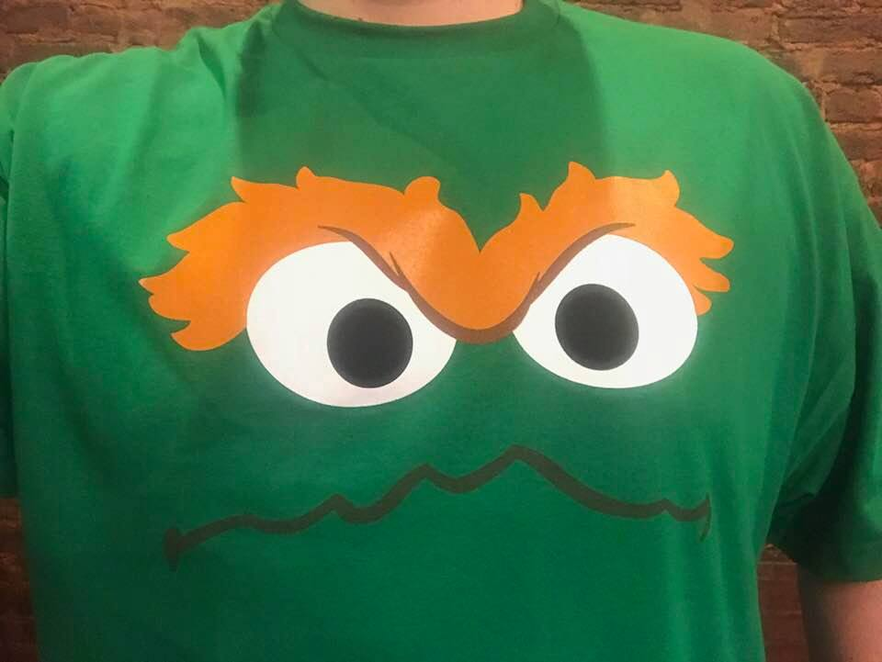
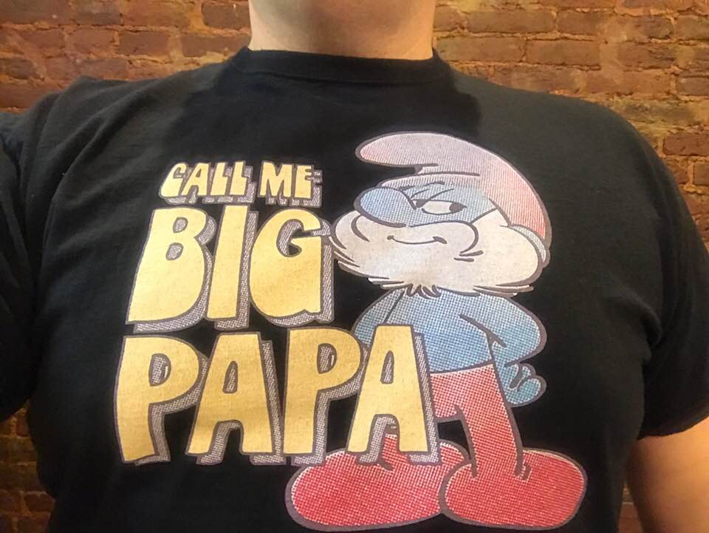
Have fun with it!
#WkndWkShirt

Slide 16
Focus on the benefits of your firm
Find ways to highlight your firm’s unique competitive advantages.
Maybe it’s that a partner will always handle your case
Maybe you will always meet an attorney at your initial client consultation
Or maybe it’s that you always return calls within 24 hours

Slide 17
Use video – seriously, do it.
Video is a great way to connect with your audience.
They get to see you, hear you, and ultimately connect with you.

Slide 18
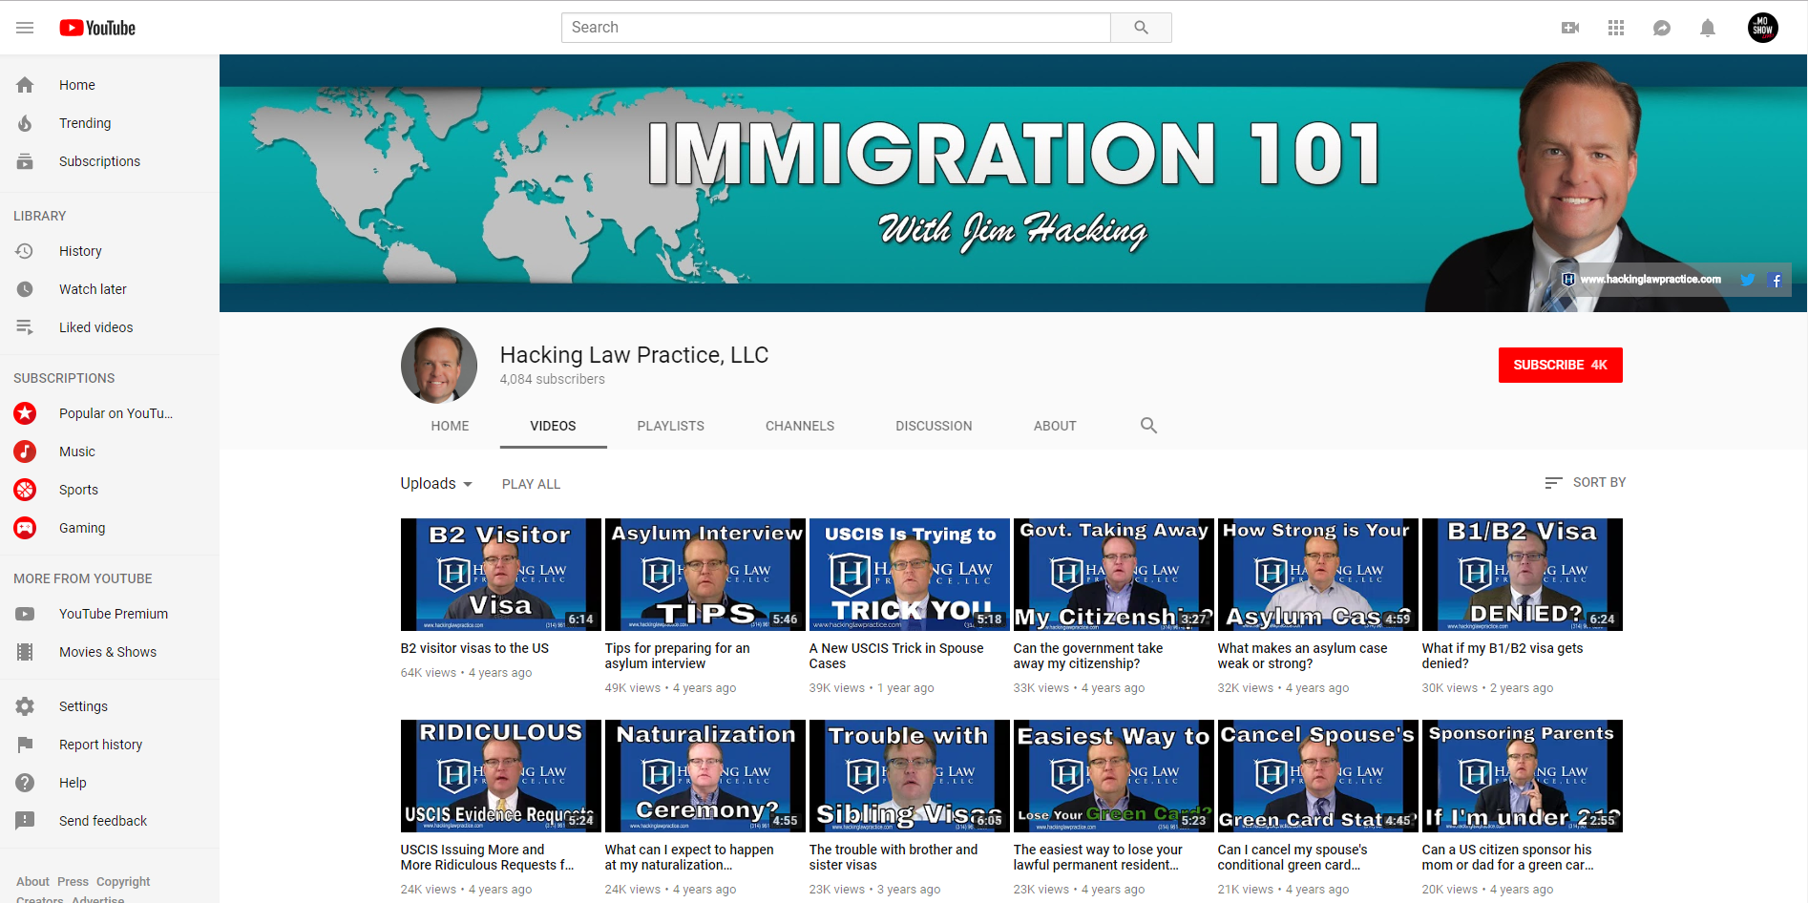
HOW CAN YOU USE VIDEO?
What type of videos?
Q&A videos for FAQs
Bio videos
Firm Overview
What do I do with
the video?
Upload to YouTube, your website, social media, Avvo, and more…

Slide 19
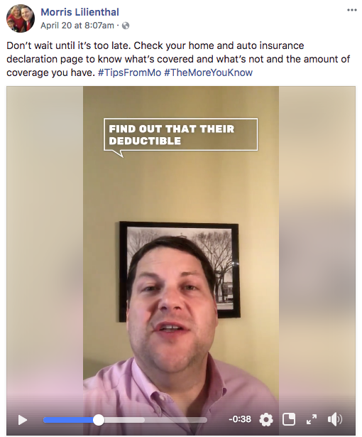
Meaningful video content
Include your “why” in your videos
The 80/20 Rule
Sharing Legal, Life & Family
#TipsFromMo

Slide 20
Who do you surround yourself with?
#TipsFromMo

Slide 21
Start your own live video show

Slide 22
How do you do it?
Pick a platform – BlueJeans or BeLive
Fast internet connection
Great lighting and audio

Slide 23
TheMoShow.Live
Pre-promote the show on social media
Write a blog post for your website and share it!
Post-promotion – share the interview on social, upload to YouTube, embed on your website.

Slide 24
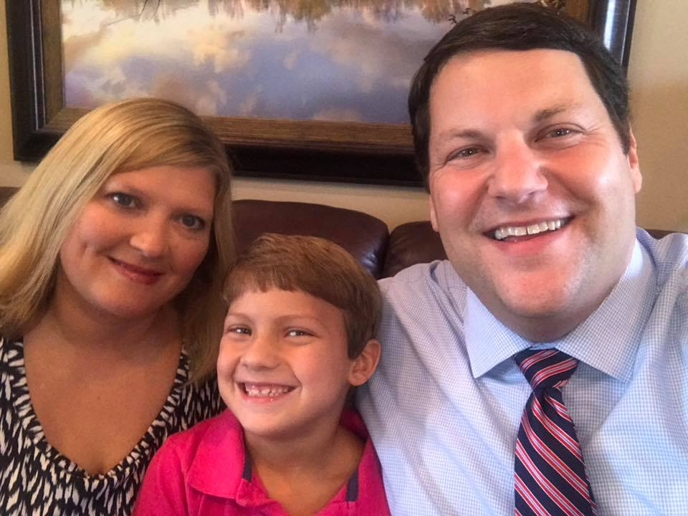
What has this done for me?
New connections
Speaking engagements
Radio interviews
TV interviews

Slide 25
5 key takeaways
Be consistent
Be Unique
Engage with others
It is a marathon, not a sprint
JUST DO IT!

Slide 26
THANK YOU!
/morris.lilienthal
@molilienthal73
@moscots73
www.MartinsonAndBeason.com

